Slide 1







ONE DAY
MYSQL WORKSHOP
Speaker Name: Muhammad Raheel

Slide 2


AGENDA
1. Introduction to Databases and MySQL | MariaDB | Oracle SQL Developer | SQLite.
- Database basics: What they are and their significance.
- Overview of MySQL | MariaDB | Oracle SQL Developer | SQLite.
2. Installation and Setup:
- Downloading, installing, and configuring MySQL | MariaDB | Oracle SQL Developer | SQLite.
- Brief demonstration of the interface.
3. Database Creation and Management:
- Creating databases and understanding their structure.
- Basics of tables, columns, and data types.
4. CRUD Operations and Querying Data:
- Hands-on demonstration of CRUD operations (Create, Read, Update, Delete) using SQL queries.
- Using SELECT statements with WHERE, ORDER BY, and LIMIT clauses.
5. Data and Table Manipulation:
- Inserting, updating, and deleting records within a table.
- Understanding ALTER TABLE and DROP TABLE commands.
6. Advanced SQL Operations:
- Exploring JOIN operations: INNER JOIN, LEFT JOIN, RIGHT JOIN.
- Introduction to Aggregate Functions: SUM, AVG, COUNT, etc., and their usage.
7. Best Practices and Optimization:
- Tips for enhancing database performance.
- Security measures and best practices to safeguard data integrity.

Slide 3
1. INTRODUCTION TO DATABASES AND MYSQL | MARIADB | ORACLE SQL DEVELOPER | SQLITE.
Structured Query Language SQL is Structured Query Language, which is a computer language for storing, manipulating, and retrieving data stored in a relational database.
SQL is the standard language for Relation Database Systems. All relational database management systems (RDBMS) like "MySQL, MS Access, Oracle, Sybase, Informix, Postgres, and SQL Server" use SQL as the standard database language.

Slide 4
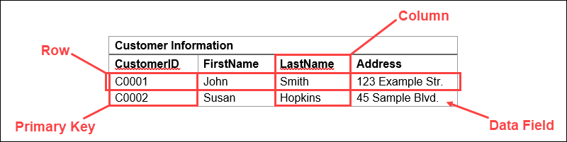
What is RDBMS:
RDBMS: Relational Database Management System
Organization: Data stored in tables with rows and columns
Relationships: Establishes connections between data sets
Query Language: Uses SQL for data retrieval and management
Efficiency: Facilitates efficient data storage and manipulation
Data Integrity: Maintains integrity through its relational structure and constraints

Slide 5
MySQL and MariaDB:
These closely related databases provide robust, open-source relational solutions renowned for their reliability, speed, and adaptability across diverse applications.
Oracle SQL Developer:
Tailored specifically for Oracle databases, this tool boasts powerful query building and optimization features, empowering efficient data management.
SQLite:
Recognized for its lightweight nature and serverless design, SQLite caters well to smaller projects, offering an ideal solution for local storage needs.
Databases' Significance:
Structured repositories like databases efficiently manage and organize data, serving as integral components in web development, enterprise systems, and various other applications.

Slide 6
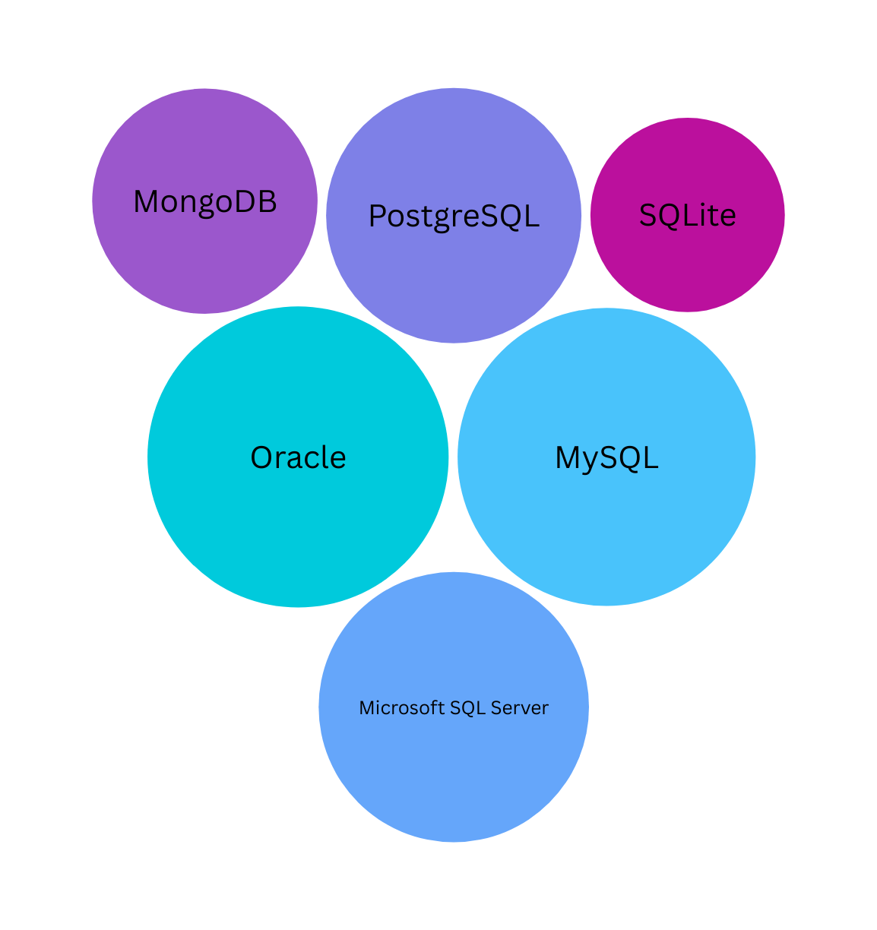
CHART OF
YEAR 2022

Slide 7
2. INSTALLATION AND SETUP
Click and Download
Step 1:
Go to the official website of MySQL and download the community server edition software. Here, you will see the option to choose the Operating System, such as Windows.
Step 2:
Next, there are two options available to download the setup. Choose the version number for the MySQL community server, which you want. If you have good internet connectivity, then choose the mysql-installer-web-community. Otherwise, choose the other one.

Slide 8
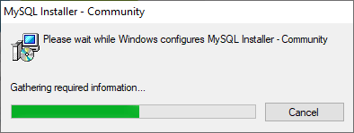
Step 3:
After downloading the setup, unzip it anywhere and double-click the MSI installer .exe file. It will give the following screen:

Slide 9
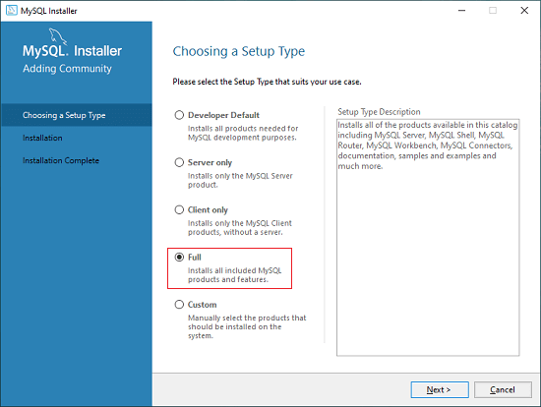
Step 4:
In the next wizard, choose the Setup Type. There are several types available, and you need to choose the appropriate option to install MySQL products and features. Here, we are going to select the Full option and click on the Next button.

Slide 10
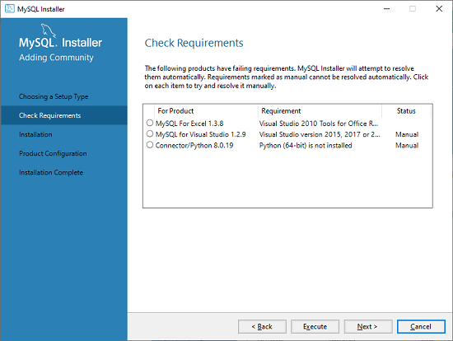
Step 5:
Once we click on the Next button, it may give information about some features that may fail to install on your system due to a lack of requirements. We can resolve them by clicking on the Execute button that will install all requirements automatically or can skip them. Now, click on the Next button.

Slide 11
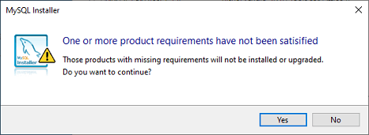
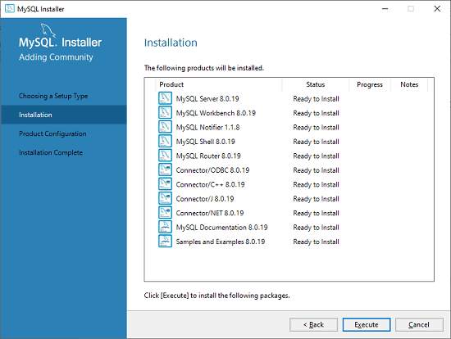
Step 6:
In the next wizard, we will see a dialog box that asks for our confirmation of a few products not getting installed. Here, we have to click on the Yes button.
After clicking on the Yes button, we will see the list of the products which are going to be installed. So, if we need all products, click on the Execute button.

Slide 12
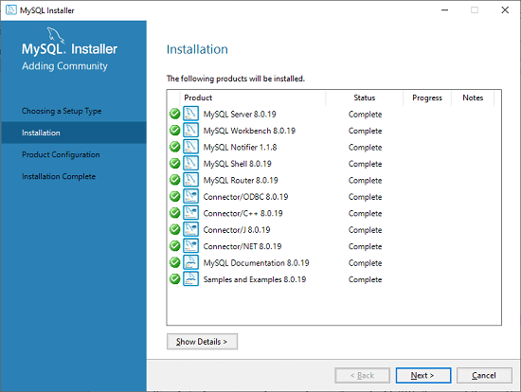
Step 7:
Once we click on the Execute button, it will download and install all the products. After completing the installation, click on the Next button

Slide 13
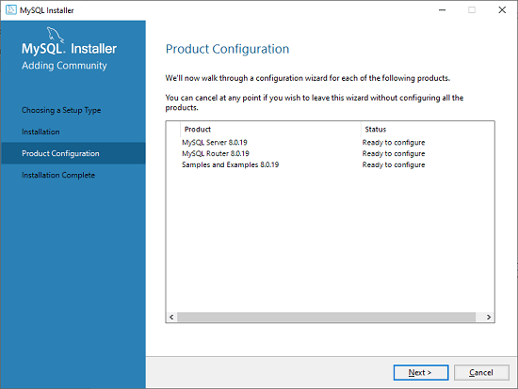
Step 8:
In the next wizard, we need to configure the MySQL Server and Router. Here, I am not going to configure the Router because there is no need to use it with MySQL. We are going to show you how to configure the server only. Now, click on the Next button.

Slide 14
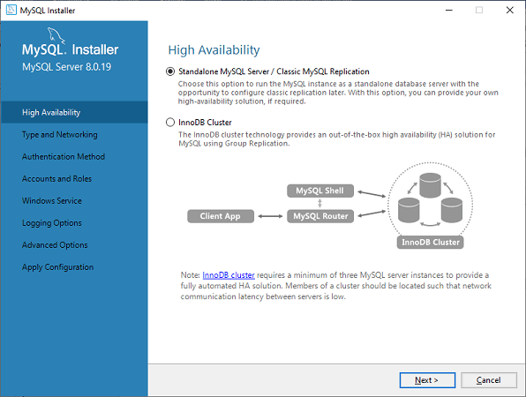
Step 9:
As soon as you click on the Next button, you can see the screen below. Here, we have to configure the MySQL Server. Now, choose the Standalone MySQL Server/Classic MySQL Replication option and click on Next. Here, you can also choose the InnoDB Cluster based on your needs.

Slide 15
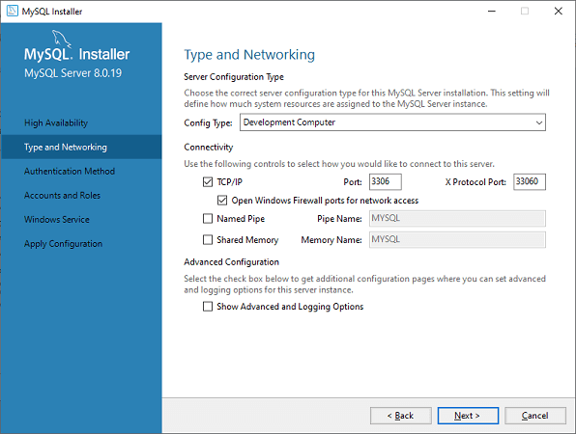
Step 10:
In the next screen, the system will ask you to choose the Config Type and other connectivity options. Here, we are going to select the Config Type as 'Development Machine' and Connectivity as TCP/IP, and the Port Number is 3306, then click on Next.

Slide 16
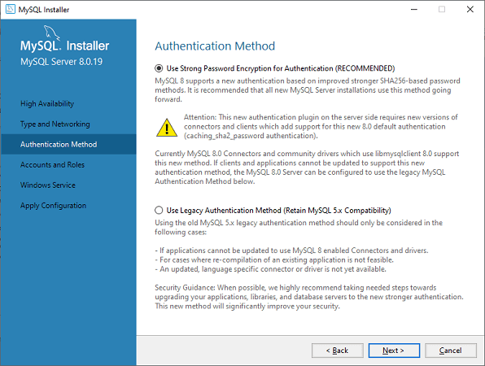
Step 11:
Now, select the Authentication Method and click on Next. Here, I am going to select the first option.

Slide 17
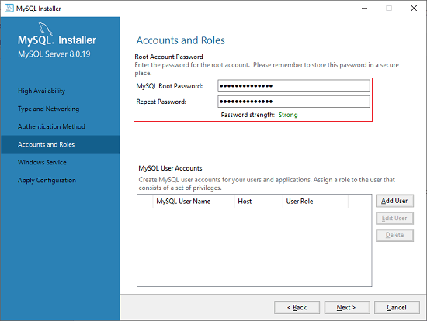
Step 12:
The next screen will ask you to mention the MySQL Root Password. After filling the password details, click on the Next button.

Slide 18
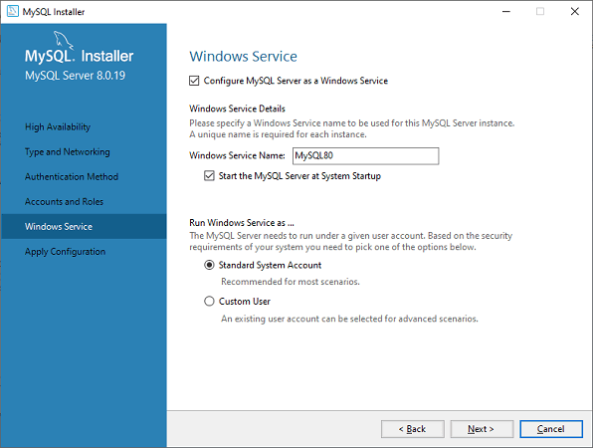
Step 13:
The next screen will ask you to configure the Windows Service to start the server. Keep the default setup and click on the Next button.

Slide 19
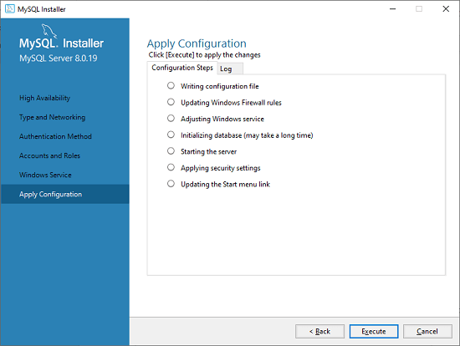
Step 14:
In the next wizard, the system will ask you to apply the Server Configuration. If you agree with this configuration, click on the Execute button.

Slide 20
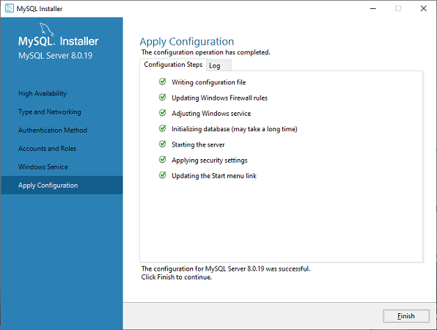
Step 15:
Once the configuration has been completed, you will get the screen below. Now, click on the Finish button to continue.

Slide 21

Step 16:
In the next screen, you can see that the Product Configuration is completed. Keep the default setting and click on the Next-> Finish button to complete the MySQL package installation.

Slide 22
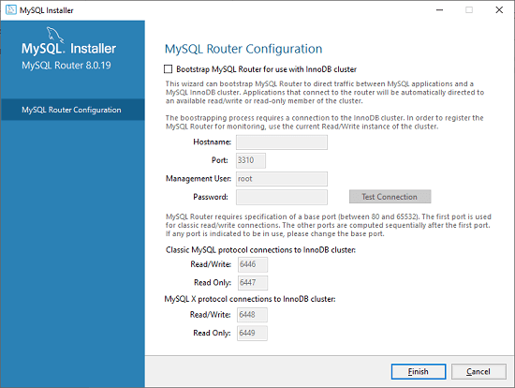
Step 17:
In the next wizard, we can choose to configure the Router. So click on Next->Finish and then click the Next button.

Slide 23
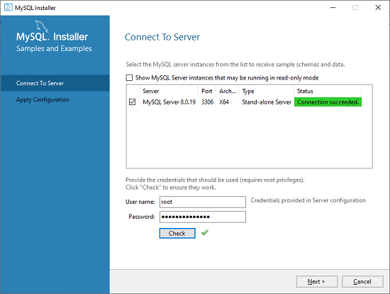
Step 18:
In the next wizard, we will see the Connect to Server option. Here, we have to mention the root password, which we had set in the previous steps.
In this screen, it is also required to check whether the connection is successful or not by clicking on the Check button. If the connection is successful, click on the Execute button. Now, the configuration is complete, click on Next.

Slide 24
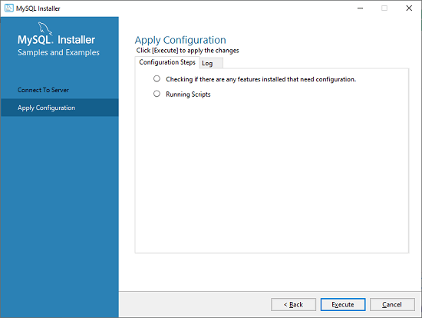
Step 19:
In the next wizard, select the applied configurations and click on the Execute button.

Slide 25
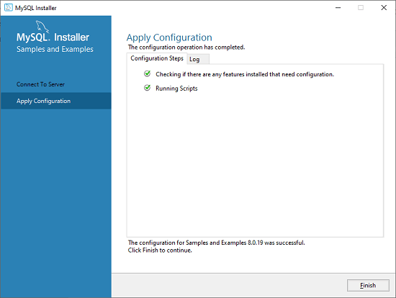
Step 20:
After completing the above step, we will get the following screen. Here, click on the Finish button.

Slide 26
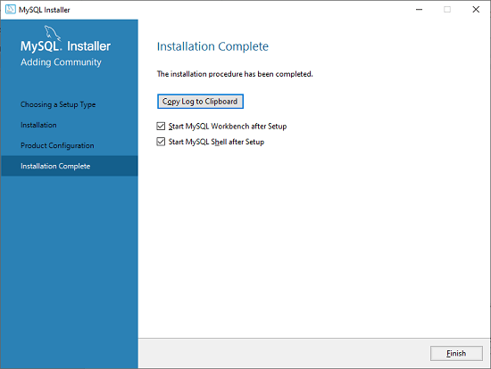
Step 21:
Now, the MySQL installation is complete. Click on the Finish button.

Slide 27
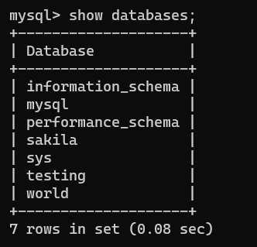
Now Let's Do Some Queries
SHOW DATABASES;
...........or..............
show databases;
"SHOW DATABASES" is a command in MySQL that lists all the available databases on the current server. It gives you an overview of the databases present, allowing you to choose and work within a specific database.

Slide 28
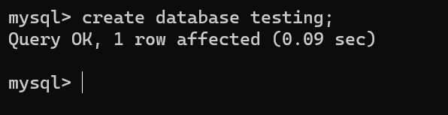
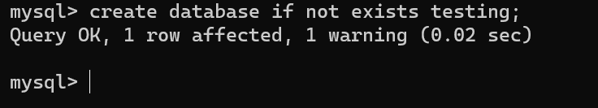
CREATE DATABASE
CREATE DATABASE testing;
..................or...........................
create database testing;
The command "CREATE DATABASE testing" in MySQL is used to create a new database named "testing." This command creates a fresh database within the MySQL server, ready to store and manage data.
CREATE DATABASE IF NOT EXISTS testing;
................................or.....................................
create database if not exists testing;
"CREATE DATABASE IF NOT EXISTS testing;" makes a new database called "testing" only if it doesn't exist already, preventing any issues if it's already there.

Slide 29
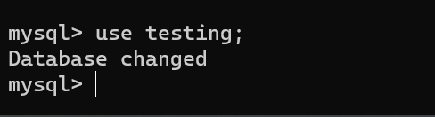
USE testing;
.........or.........
use testing;
The command "USE testing;" in MySQL is used to switch to or select the database named "testing." Once executed, any subsequent operations or queries will be applied to the "testing" database until you switch to a different database or session ends.
CREATE TABLE employee (employee_id INT(10), employee_name VARCHAR(255), employee_address VARCHAR(255));
................................or..........................................
create table employee (employee_id int(10), employee_name varchar(255), employee_address varchar(255));
The command "CREATE TABLE employee (employee_id INT(10), employee_name VARCHAR(255), employee_address VARCHAR(255));" in MySQL creates a table named "employee" with columns for employee ID, name, and address. The specified data types for columns are INT for the ID (allowing up to 10 digits) and VARCHAR for the name and address (allowing up to 255 characters).

Slide 30
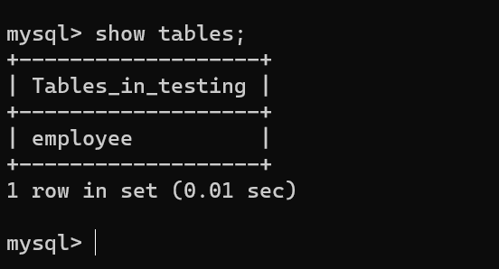
CREATE TABLE
CREATE TABLE IF NOT EXISTS employee (employee_id INT(10), employee_name VARCHAR(255), employee_address VARCHAR(255));
................................or..........................................
create table if not exists employee (employee_id int(10), employee_name varchar(255), employee_address varchar(255));
The command "CREATE TABLE IF NOT EXISTS employee (employee_id INT(10), employee_name VARCHAR(255), employee_address VARCHAR(255));" in MySQL creates a table named "employee" with columns for employee ID, name, and address. If the "employee" table already exists, this command ensures that it won't be recreated, preventing any potential conflicts or errors.
SHOW TABLES;
....or.....
show tables;
The command "SHOW TABLES;" in MySQL displays a list of all the tables within the currently selected database. This command provides an overview of the tables available in the database you're currently working in.

Slide 31
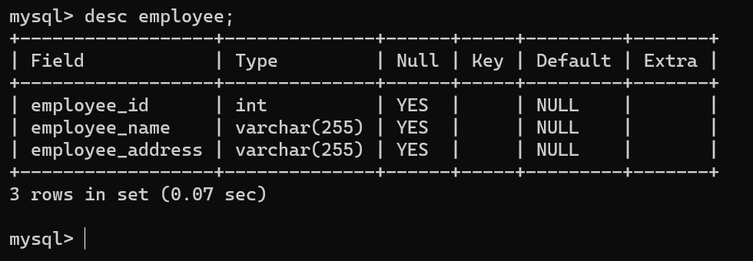
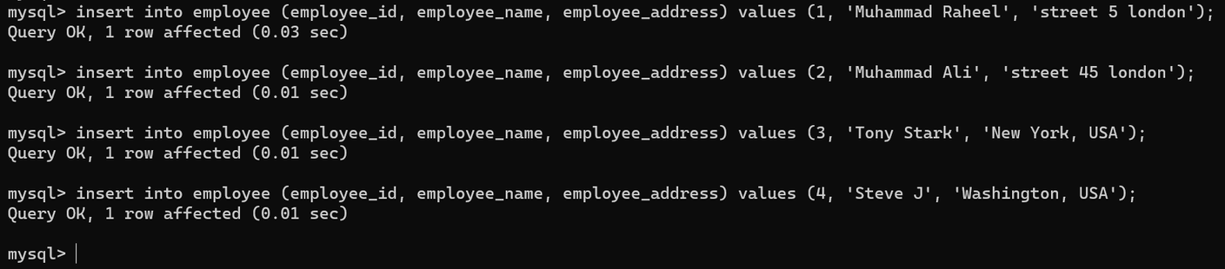
DESC employee;
.....or.....
desc employee;
.....or.....
DESCRIBE employee;
.....or.....
describe employee;
The command "DESC employee;" in MySQL provides a description or structure of the "employee" table, showing details about its columns such as name, data type, length, and any additional attributes set for each column.
INSERT TABLE
INSERT INTO employee (employee_id, employee_name, employee_address) VALUES (1, 'Muhammad Raheel', 'street 5 london');
...............................or........................
insert into employee (employee_id, employee_name, employee_address) values (1, 'Muhammad Raheel', 'street 5 london');
The command you provided, "insert into employee (employee_id, employee_name, employee_address) values (1, 'Muhammad Raheel', 'street 5 London');", inserts a new record into the "employee" table with an ID of 1, the name "Muhammad Raheel", and the address "street 5 London". This command adds a new entry to the table with the specified information in the respective columns.

Slide 32
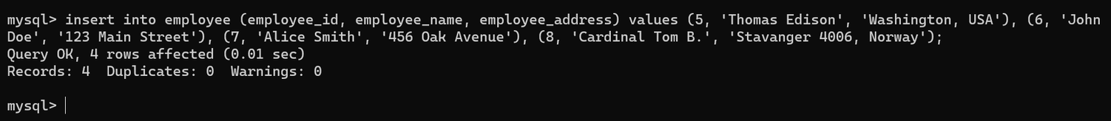
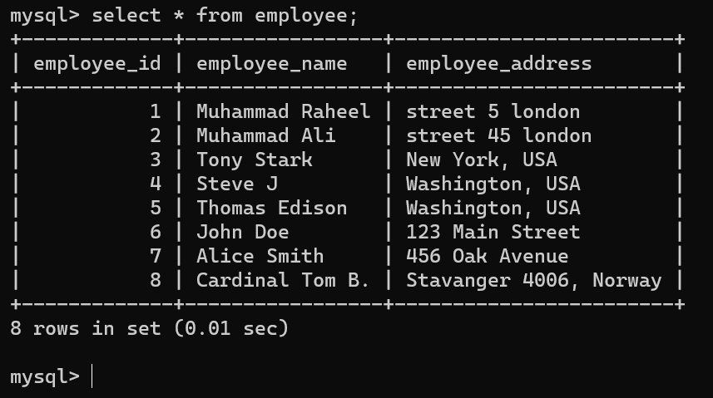
INSERT INTO employee (employee_id, employee_name, employee_address) VALUES (5, 'Thomas Edison', 'Washington, USA'), (6, 'John Doe', '123 Main Street'), (7, 'Alice Smith', '456 Oak Avenue'), (8, 'Cardinal Tom B.', 'Stavanger 4006, Norway');
.......................or............................
insert into employee (employee_id, employee_name, employee_address) values (5, 'Thomas Edison', 'Washington, USA'), (6, 'John Doe', '123 Main Street'), (7, 'Alice Smith', '456 Oak Avenue'), (8, 'Cardinal Tom B.', 'Stavanger 4006, Norway');
This SQL statement inserts multiple records into the "employee" table in one go. It adds four new entries to the table, each with a distinct ID, name, and address specified within the VALUES section.
SELECT * FROM employee;
........or..........
select * from employee;
The query "SELECT * FROM employee;" retrieves all records from the "employee" table, displaying the complete information stored across all columns for every entry in the table.

Slide 33
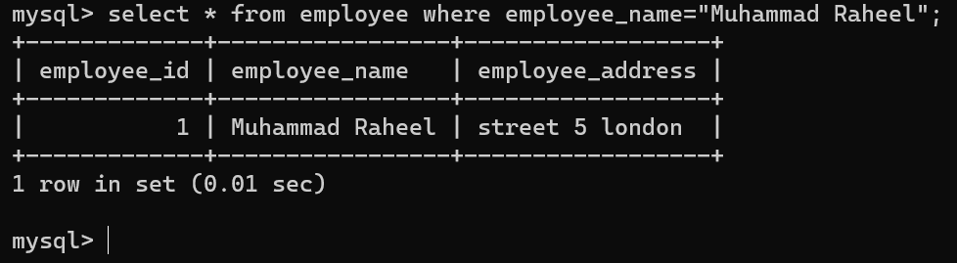
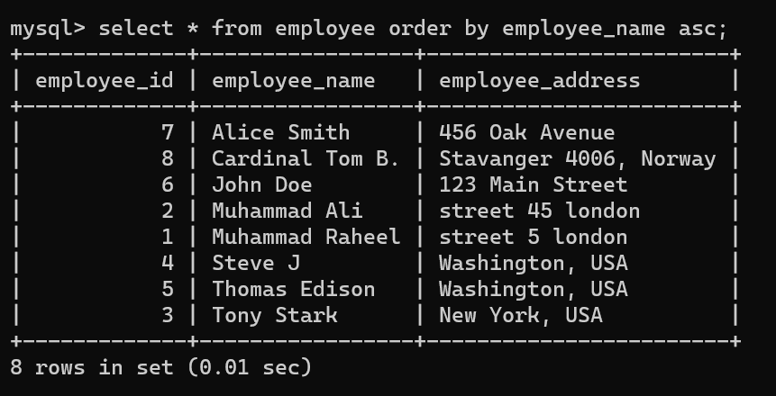
SELECT * FROM employee WHERE employee_name="Muhammad Raheel";
...................or.......................
select * from employee where employee_name="Muhammad Raheel";
The query "SELECT * FROM employee WHERE employee_name='Muhammad Raheel';" fetches all records from the "employee" table where the "employee_name" column matches the value 'Muhammad Raheel'.
SELECT * FROM employee ORDER BY employee_name ASC;
...............or..................
select * from employee order by employee_name asc;
The query "SELECT * FROM employee ORDER BY employee_name ASC;" retrieves all records from the "employee" table and arranges them in ascending order based on the values in the "employee_name" column.

Slide 34
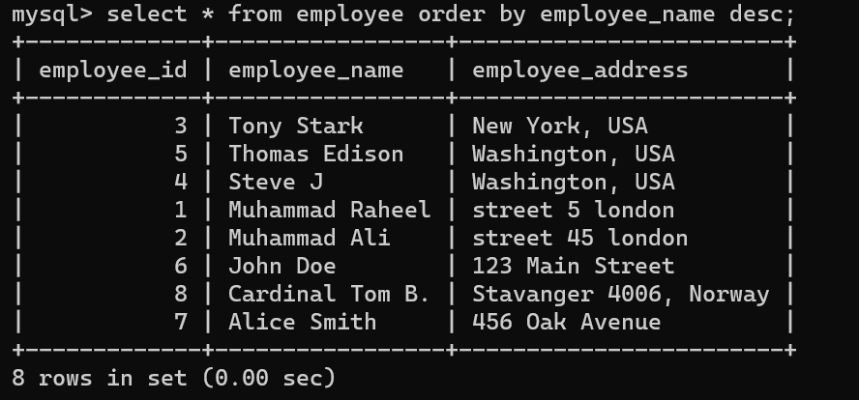
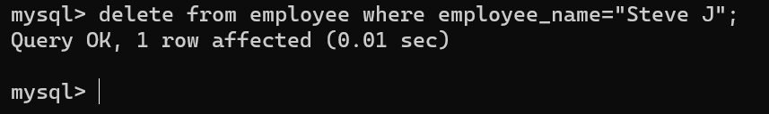
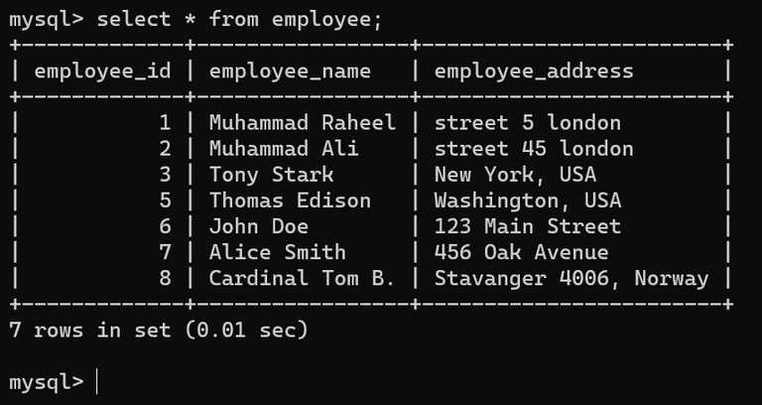
SELECT * FROM employee ORDER BY employee_name DESC;
.......................or......................
select * from employee order by employee_name desc;
The query "SELECT * FROM employee ORDER BY employee_name DESC;" fetches all records from the "employee" table and sorts them in descending order based on the values in the "employee_name" column.
DELETE FROM employee WHERE employee_name='Steve J';
...................or......................
delete from employee where employee_name='Steve J';
The query "DELETE FROM employee WHERE employee_name='Steve J';" removes records from the "employee" table where the "employee_name" column matches the value 'Steve J'. This will delete the respective entry or entries associated with the name 'Steve J' from the table.

Slide 35
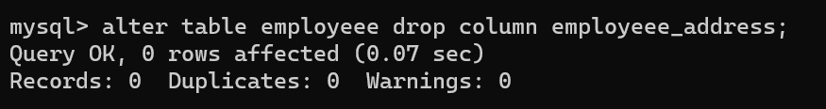
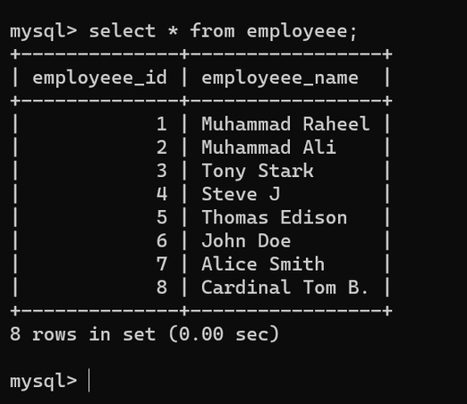
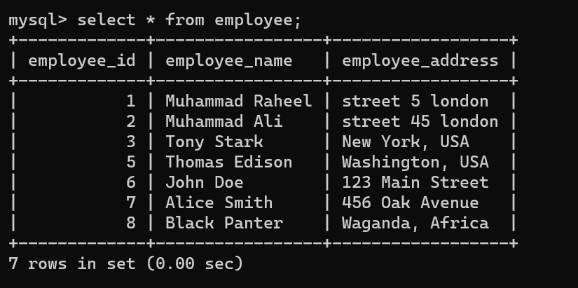
ALTER TABLE employee DROP COLUMN employee_address;
..............or................
alter table employeee drop column employeee_address;
The query "ALTER TABLE employee DROP COLUMN employee_address;" in MySQL alters the "employee" table by removing or dropping the column named "employee_address" from the table's structure. This action permanently deletes the specified column and its data from the table.
UPDATE employee SET employee_name='Black Panther', employee_address='Wakanda, Africa' WHERE employee_id=8;
.......................or....................................
update employee set employee_name="Black Panter", employee_address="Waganda, Africa" where employee_id=8;
This SQL statement updates the "employee_name" to 'Black Panther' and the "employee_address" to 'Wakanda, Africa' for the employee with an ID of 8 in the "employee" table.

Slide 36
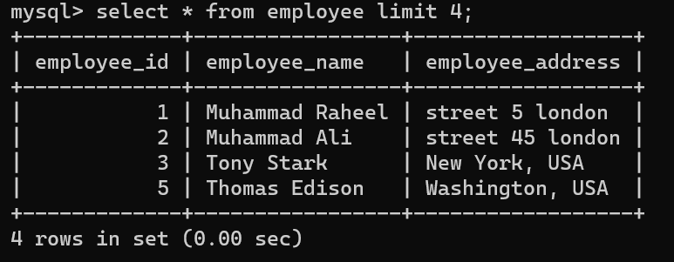
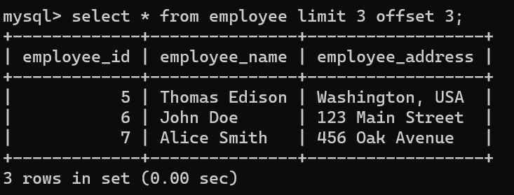
SELECT * FROM employee LIMIT 4;
...........or..............
select * from employee limit 4;
The query "SELECT * FROM employee LIMIT 4;" retrieves the first four records from the "employee" table, displaying all columns for those specific four entries.
SELECT * FROM employee LIMIT 3 OFFSET 3;
..........or............
select * from employee limit 3 offset 3;
The query "SELECT * FROM employee LIMIT 3 OFFSET 3;" retrieves three records from the "employee" table starting from the fourth record (offset of 3). This means it skips the first three records and fetches the subsequent three entries.

Slide 37
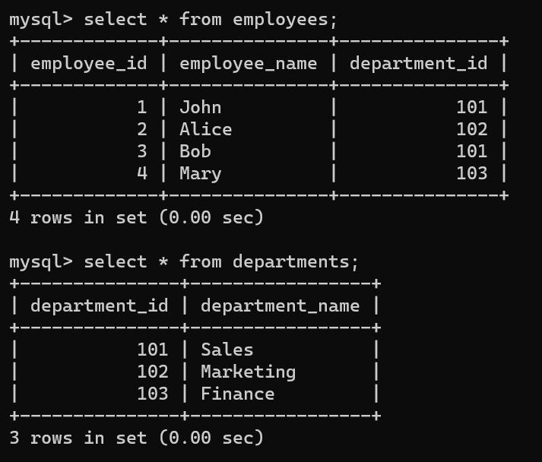
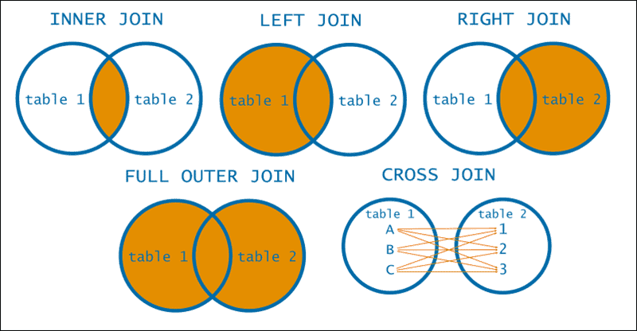
JOIN
CREATE TABLE employees (employee_id INT, employee_name VARCHAR(255), department_id INT);
CREATE TABLE departments (department_id INT, department_name VARCHAR(255));
INSERT INTO employees (employee_id, employee_name, department_id) VALUES (1, 'John', 101), (2, 'Alice', 102), (3, 'Bob', 101), (4, 'Mary', 103);
INSERT INTO departments (department_id, department_name) VALUES (101, 'Sales'), (102, 'Marketing'), (103, 'Finance');

Slide 38
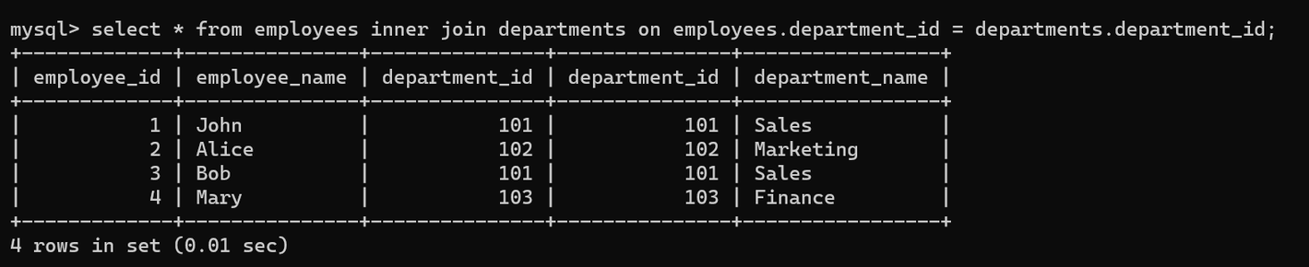
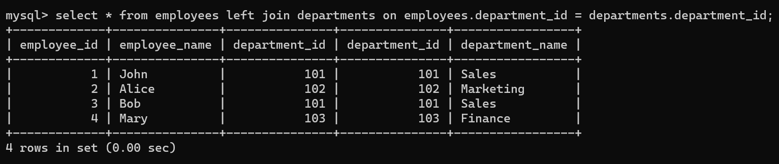
INNER JOIN
SELECT * FROM employees INNER JOIN departments ON employees.department_id = departments.department_id;
.................or...................
select * from employees inner join departments on employees.department_id = departments.department_id;
This command retrieves all columns from the 'employees' table and combines them with corresponding records from the 'departments' table based on their shared 'department_id'.
LEFT JOIN
SELECT * FROM employees LEFT JOIN departments ON employees.department_id = departments.department_id;
...................or..................
select * from employees left join departments on employees.department_id = departments.department_id;
This command retrieves all columns from the 'employees' table and combines them with related records from the 'departments' table based on their shared 'department_id'. Unlike an INNER JOIN, a LEFT JOIN includes all records from the 'employees' table, regardless of whether there's a match in the 'departments' table. If there's no match, the corresponding 'departments' columns will be filled with NULL values.

Slide 39
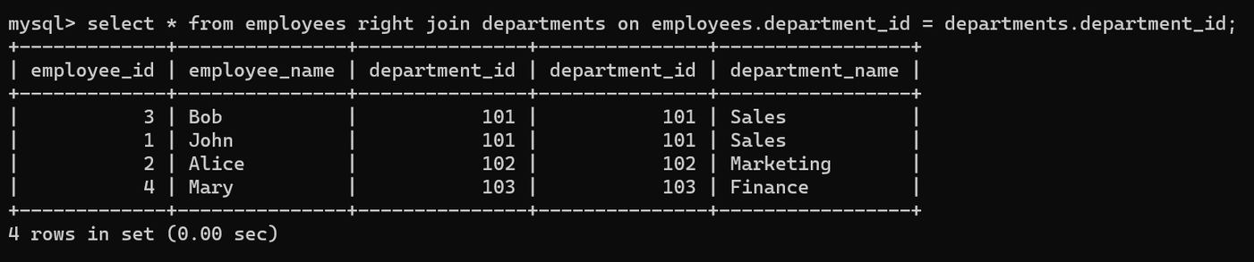
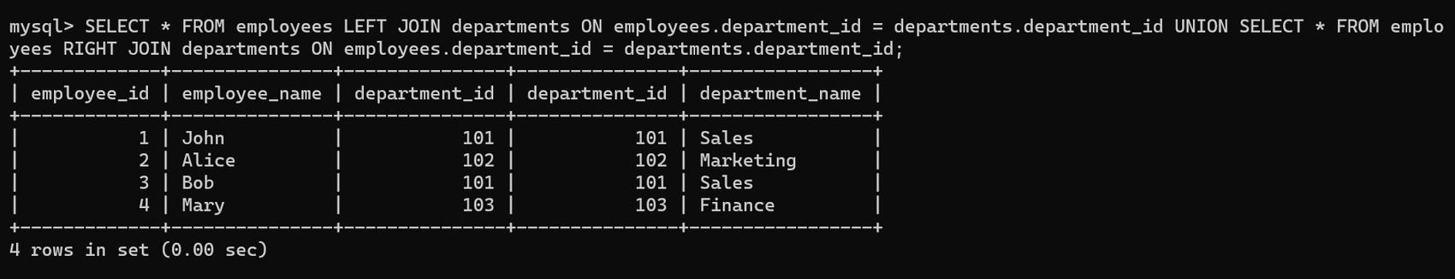
RIGHT JOIN
SELECT * FROM employees RIGHT JOIN departments ON employees.department_id = departments.department_id;
...................or.......................
select * from employees right join departments on employees.department_id = departments.department_id;
This command retrieves all columns from the 'employees' table and includes related records from the 'departments' table based on their shared 'department_id'. Using a RIGHT JOIN ensures that all records from the 'departments' table are included, regardless of whether there's a match in the 'employees' table. If there's no match, the corresponding 'employees' columns will be filled with NULL values.
FULL OUTER JOIN
SELECT * FROM employees LEFT JOIN departments ON employees.department_id = departments.department_id UNION SELECT * FROM employees RIGHT JOIN departments ON employees.department_id = departments.department_id;
This query retrieves all columns from the 'employees' table and combines them with related records from the 'departments' table using both LEFT JOIN and RIGHT JOIN. The UNION operator combines the results of the LEFT JOIN and RIGHT JOIN into a single result set, excluding duplicates. This means it includes all records from both tables, ensuring a comprehensive view of the combined data based on the 'department_id'.

Slide 40
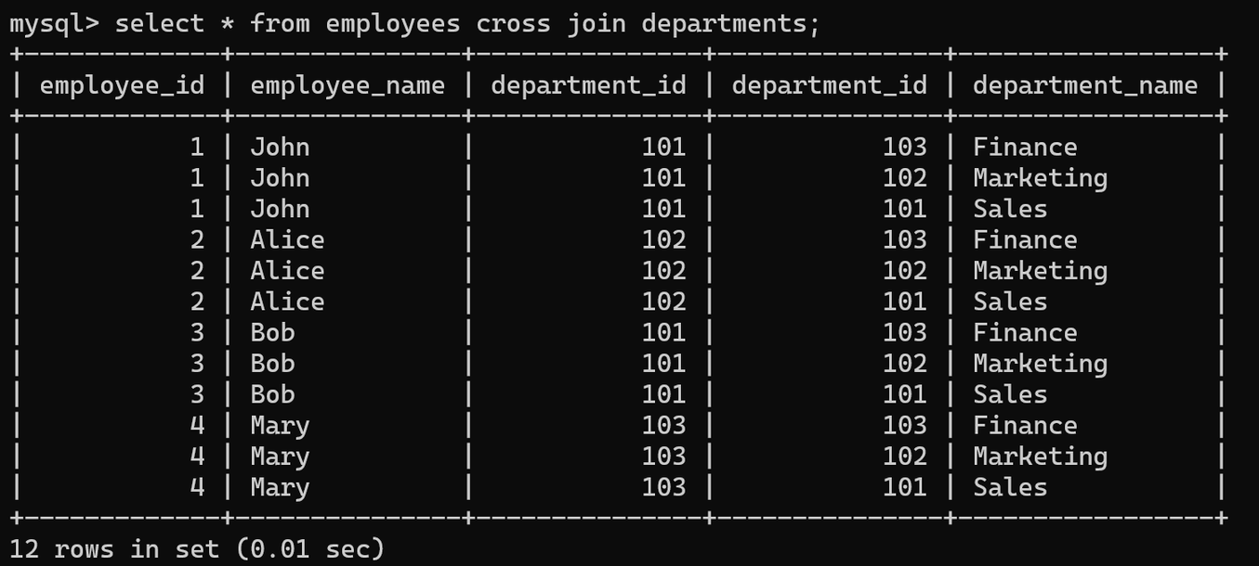
CROSS JOIN
CREATE TABLE employees (employee_id INT, employee_name VARCHAR(255), department_id INT);
CREATE TABLE departments (department_id INT, department_name VARCHAR(255));
INSERT INTO employees (employee_id, employee_name, department_id) VALUES (1, 'John', 101), (2, 'Alice', 102), (3, 'Bob', 101), (4, 'Mary', 103);
INSERT INTO departments (department_id, department_name) VALUES (101, 'Sales'), (102, 'Marketing'), (103, 'Finance');
select * from employees cross join departments;
The query `SELECT * FROM employees CROSS JOIN departments;` performs a CROSS JOIN between the `employees` and `departments` tables. This generates a result set containing every combination of rows from both tables, displaying each employee paired with every department, resulting in a Cartesian product of their rows.
Explanation: A CROSS JOIN combines each row from one table with every row from another table, resulting in a Cartesian product. If Table A has 3 rows and Table B has 3 rows, their CROSS JOIN will yield 3 x 3 = 9 rows, showing all possible pairings between the rows of both tables.

Slide 41
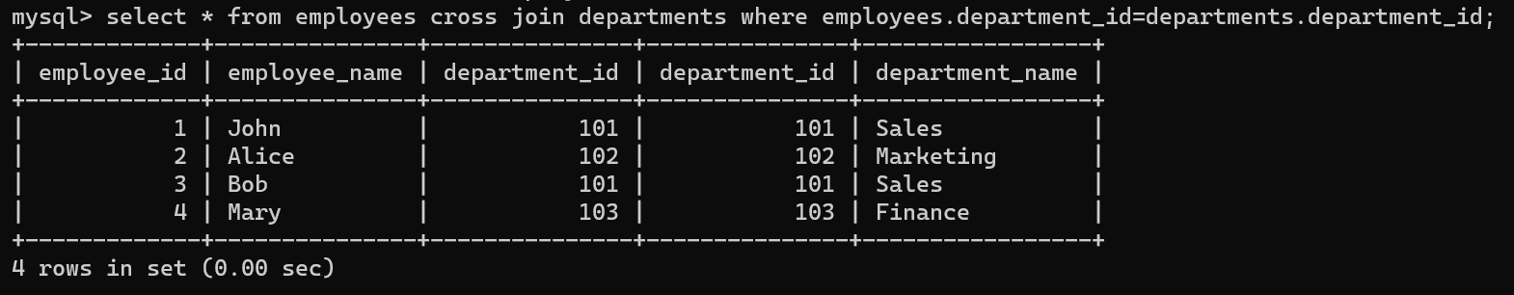
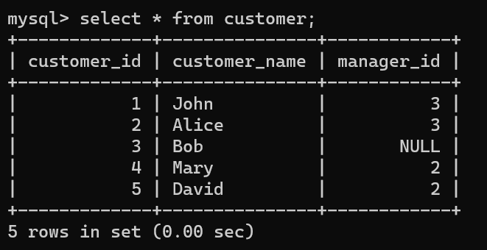
select * from employees cross join departments where employees.department_id=departments.department_id;
This command performs a `CROSS JOIN` between the 'employees' and 'departments' tables. However, the additional condition `employees.department_id = departments.department_id` is attempting to filter the result based on a match between the 'department_id' columns from both tables. In a `CROSS JOIN`, this condition doesn't have any effect as it pairs all rows from 'employees' with all rows from 'departments', disregarding matching criteria.
SELF JOIN
CREATE TABLE customer (customer_id int, customer_name varchar(255), manager_id INT);
INSERT INTO customer (customer_id, customer_name, manager_id) VALUES(1, 'John', 3),(2, 'Alice', 3),(3, 'Bob', NULL),(4, 'Mary', 2),(5, 'David', 2);

Slide 42
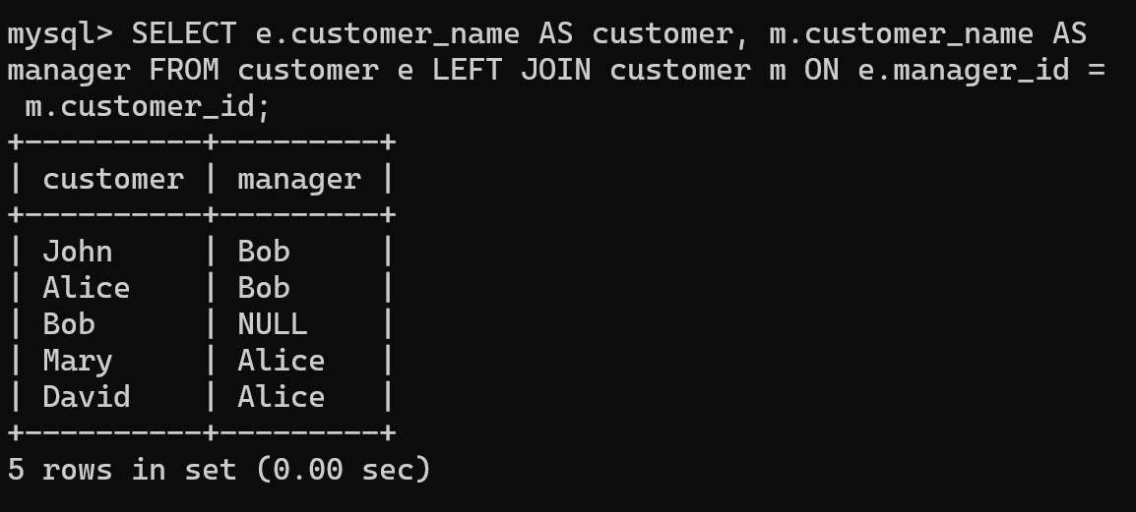
SELECT e.customer_name AS customer, m.customer_name AS manager FROM customer e LEFT JOIN customer m ON e.manager_id = m.customer_id;
...................or......................
select e.customer_name as customer, m.customer_name as manager as customer e left join customer m on e.manager_id = m.customer_id;
This command retrieves customer names (`customer`) and their corresponding manager names (`manager`). It connects the `customer` table with itself using `manager_id` and `customer_id`, displaying each customer alongside their respective manager. If a customer doesn't have a manager, it shows 'NULL' for the manager's name.
AGGREGATE FUNCTIONS
Aggregate functions in SQL perform calculations on a set of values and return a single value. These functions allow you to compute summaries such as sum, average, count, minimum, or maximum across a group of rows.
Common aggregate functions include:
COUNT: Counts the number of rows in a specified column.
SUM: Calculates the sum of values in a specified column.
AVG: Computes the average of values in a specified column.
MIN: Retrieves the minimum value in a specified column.
MAX: Retrieves the maximum value in a specified column.
These functions are often used with the `GROUP BY` clause to perform calculations on groups of rows, dividing the data into subsets based on the values in specific columns.

Slide 43


CREATE TABLE office (employee_id INT, employee_name VARCHAR(50), department_id INT, salary DECIMAL(10, 2));
mysql> INSERT INTO office (employee_id, employee_name, department_id, salary) VALUES (1, 'John', 101, 50000.00), (2, 'Alice', 102, 60000.00), (3, 'Bob', 101, 55000.00), (4, 'Mary', 103, 62000.00), (5, 'David', 101, 58000.00), (6, 'Eva', 102, 63000.00);
This command retrieves customer names (`customer`) and their corresponding manager names (`manager`). It connects the `customer` table with itself using `manager_id` and `customer_id`, displaying each customer alongside their respective manager. If a customer doesn't have a manager, it shows 'NULL' for the manager's name.
SELECT department_id, COUNT(*) AS total_employees FROM employees GROUP BY department_id;
This command retrieves the 'department_id' column and counts the number of occurrences for each 'department_id' in the 'employees' table. The GROUP BY clause then organizes the results based on 'department_id', creating groups where each group represents a unique 'department_id'. The COUNT(*) function calculates the number of rows in each group, indicating the total count of employees in each department.

Slide 44


SELECT department_id, AVG(salary) AS avg_salary FROM employees GROUP BY department_id;
This command fetches the 'department_id' column and computes the average salary for each department in the 'employees' table. It uses the `GROUP BY` clause to organize the results into groups based on 'department_id', calculating the average salary within each department using the `AVG()` function.
SELECT department_id, MAX(salary) AS max_salary FROM employees GROUP BY department_id;
This command retrieves the 'department_id' column and finds the maximum (highest) salary within each department from the 'employees' table. It utilizes the `GROUP BY` clause to group the results by 'department_id', and then applies the `MAX()` function to determine the highest salary within each department group

Slide 45



SUB QUERY
SELECT *FROM employees WHERE department_id IN (SELECT department_id FROM departments WHERE department_name = 'Sales');
This query retrieves all columns from the 'employees' table for employees who belong to the 'Sales' department. It uses a subquery in the WHERE clause to obtain the 'department_id' associated with the 'Sales' department from the 'departments' table and filters the 'employees' table based on this condition.
SELECT employee_name, department_id
FROM employees
WHERE department_id IN
(SELECT department_id
FROM departments WHERE department_name = 'Finance');
This query retrieves the 'employee_name' and 'department_id' from the 'employees' table where the 'department_id' matches any of the 'department_id' values associated with the 'Finance' department in the 'departments' table.
The inner query (SELECT department_id FROM departments WHERE department_name = 'Finance') fetches the 'department_id' for the 'Finance' department, and the outer query fetches employees who belong to this department based on their 'department_id'.

Slide 46


THANK YOU
GOD BLESS YOU

